Slide 1
Predicting ‘Down’ Turbines With Real Wind Farm Data
Max Davis

Slide 2
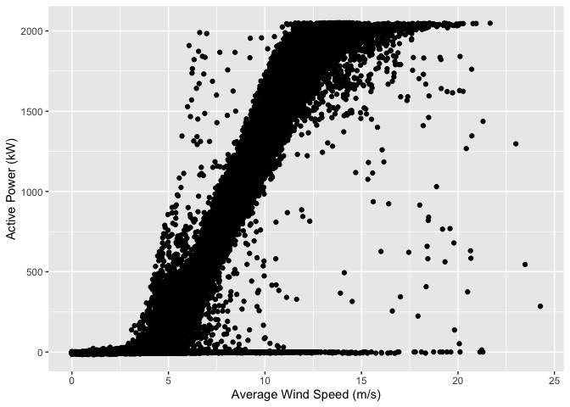
Active Power vs. Wind Speed. Note positive correlation and outliers.

Slide 3
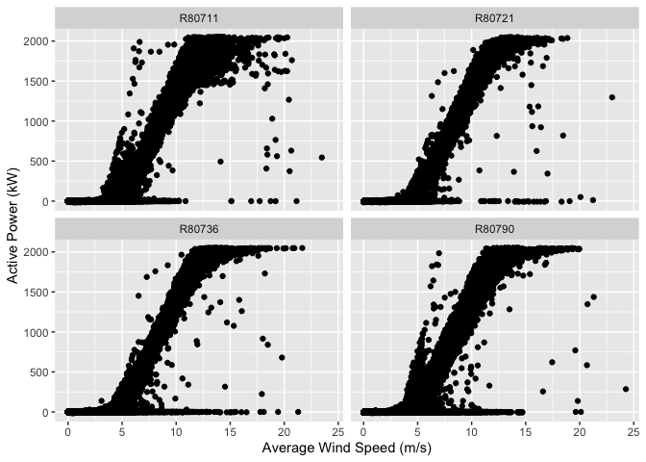
The same plot but separated by turbine.

Slide 4
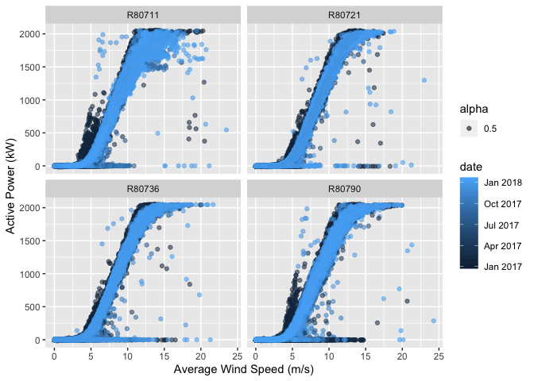
Date mapped to color shows the earlier parts of the data as darker blue.

Slide 5
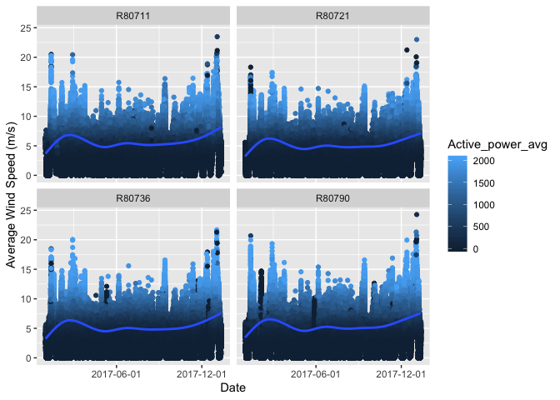
Average Wind Speed over time with Active Power mapped to color Notice the dark spikes. No power at high wind speeds.

Slide 6
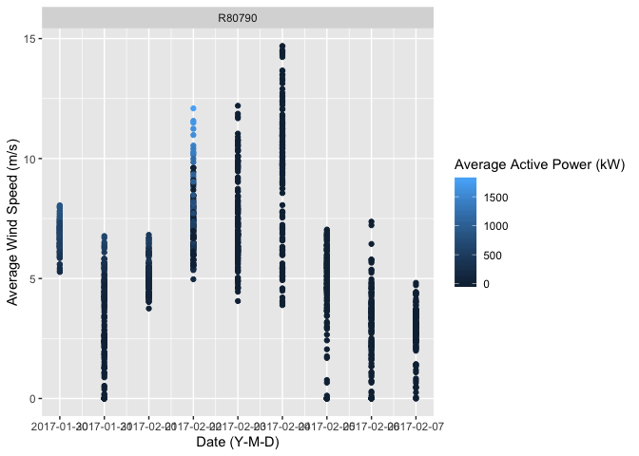
Isolated dark spike from turbine #R80790. In this week there are two days of high wind but no power.

Slide 7
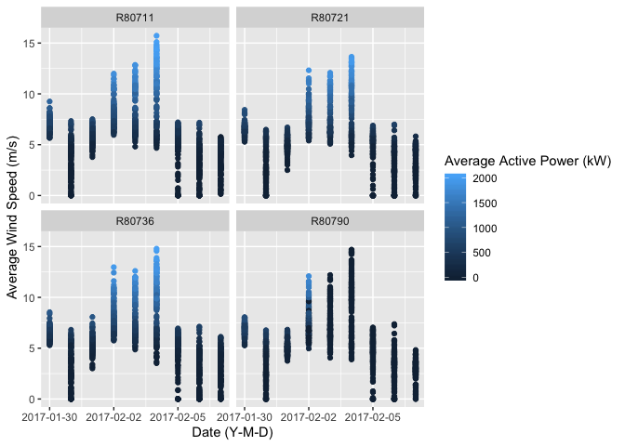
Now all four turbines, the same week.

Slide 8
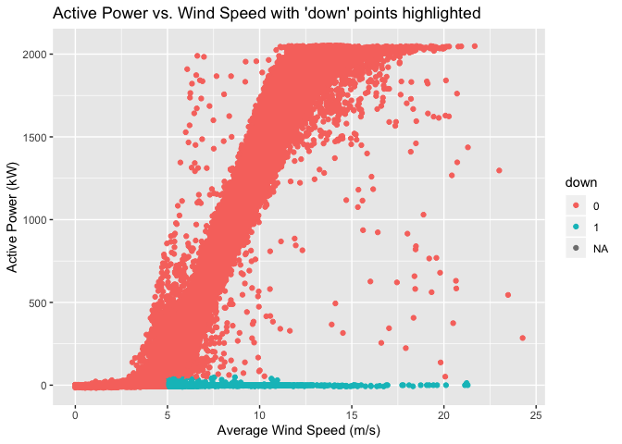
Our original plot with our new variable in light green.

Slide 9
Machine Learning
Logistic regression
The balanced and cleaned data will be split into a test and train set. The model will learn how to predict ‘down’ from the training set. We will test its accuracy on the test set.
99.37% accurate
10-fold Cross Validation
The data will be split into ten roughly equal subsets. Each will act as a test set while the rest act as a training set.
97.13% accurate
Baseline = 98.85% accurate.

Slide 10
Conclusion
Implementation
Could be used in datasets with missing values.
A first step toward more nuanced machine learning models.
Problems
‘down’ is a simplification.
Sensors are designed around components closely associated with wind speed and power.
Improvements
Time series analysis with chronological predictions.
Use of more complete domain knowledge.

